Slide 1
Sprint 3
VQA

Slide 2
Goals set for Sprint 3
Set up environment on SCC
Simulate OpenSource Model using VizWiz Dataset

Slide 3
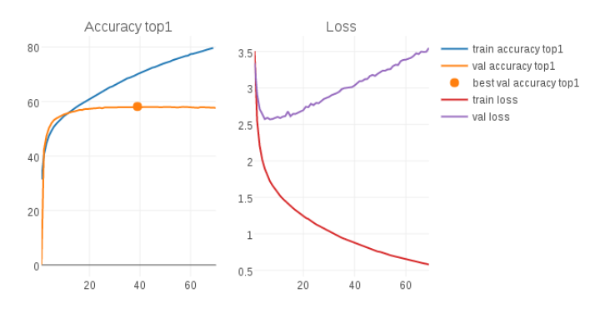
Achievements
Installed all the necessary packages and software versions on SCC
Preprocessed the images from the VizWiz Dataset
Failed to extract image features from the dataset
Ran pretrained model based on MUTAN

Slide 4
Goals for next Sprint
Complete the basic simulation of the training model
Make it compatible with other datasets
Avoid overfitting of the model based on images

